Slide 1
CS488 Project Objectives
“THE ROOM” By Anthony Tu

Slide 2
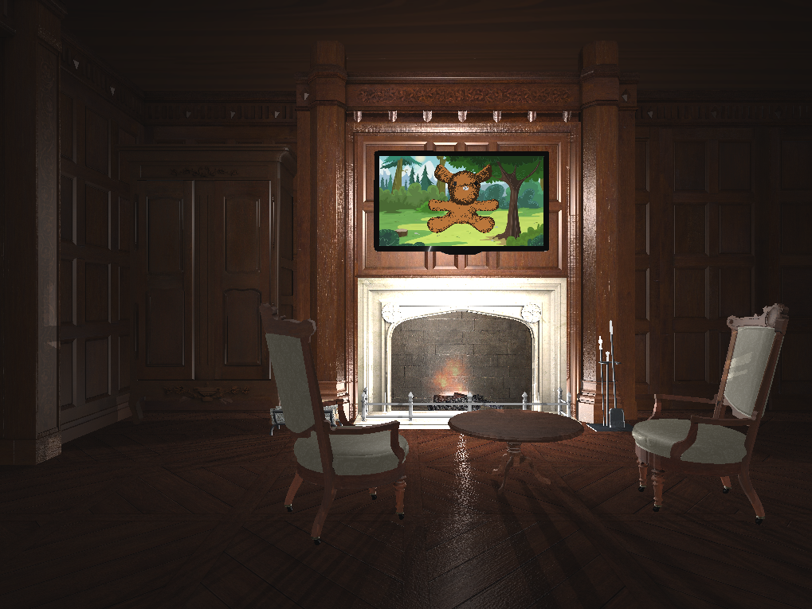
Modelling the Scene

Slide 3
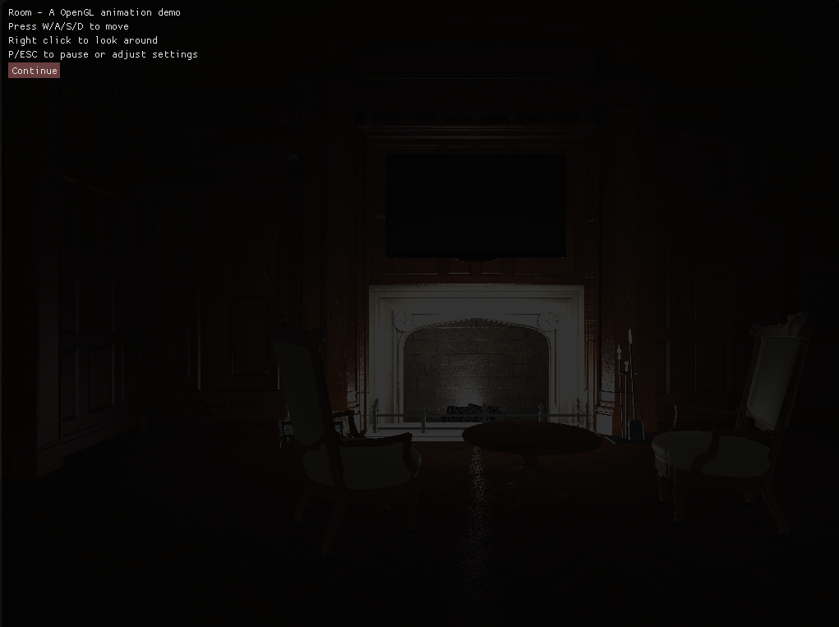
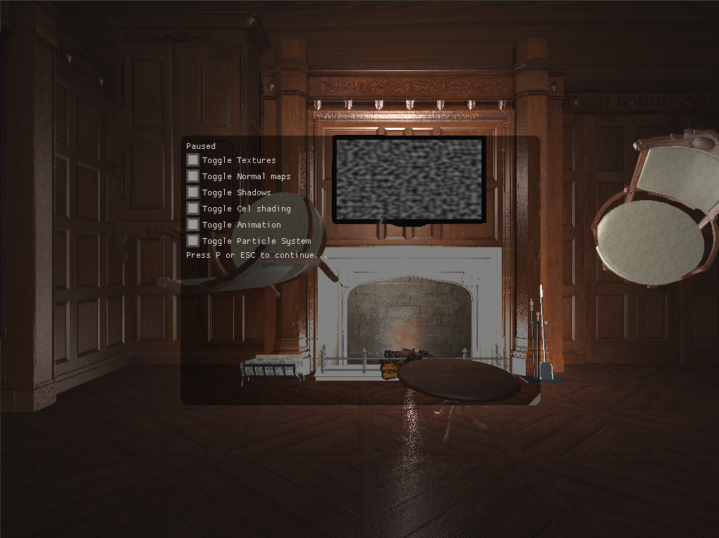
UI

Slide 4
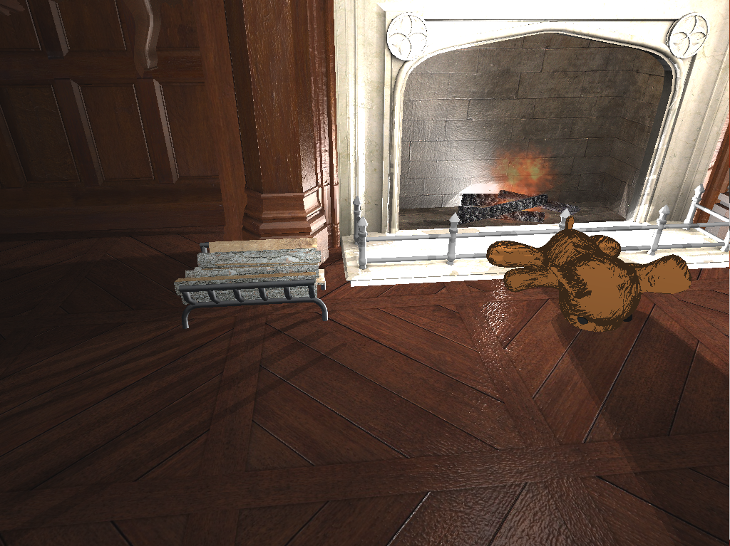
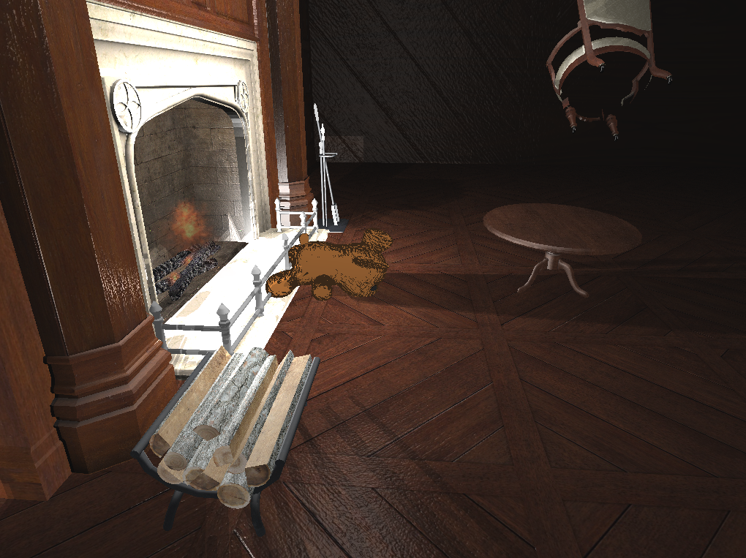
Texture/Normal Mapping

Slide 5
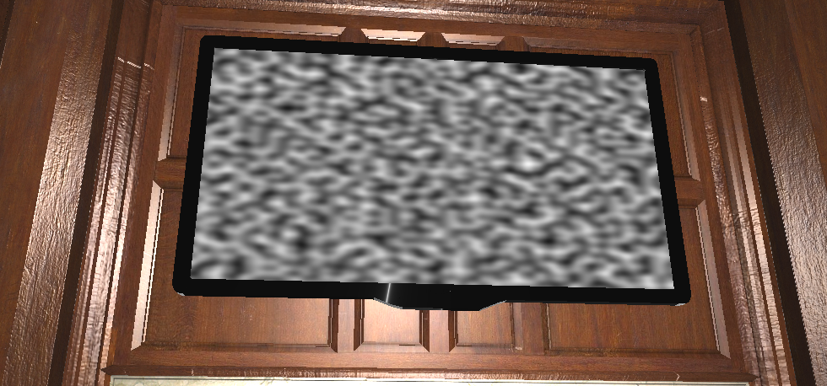
Perlin Noise

Slide 6
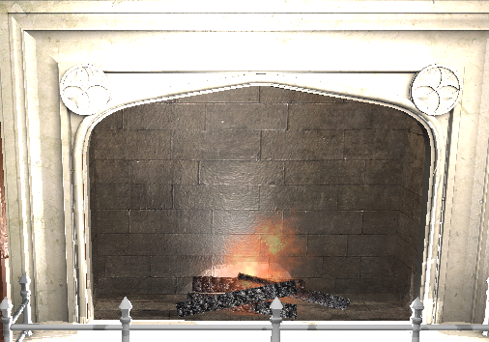
Particle Systems

Slide 7
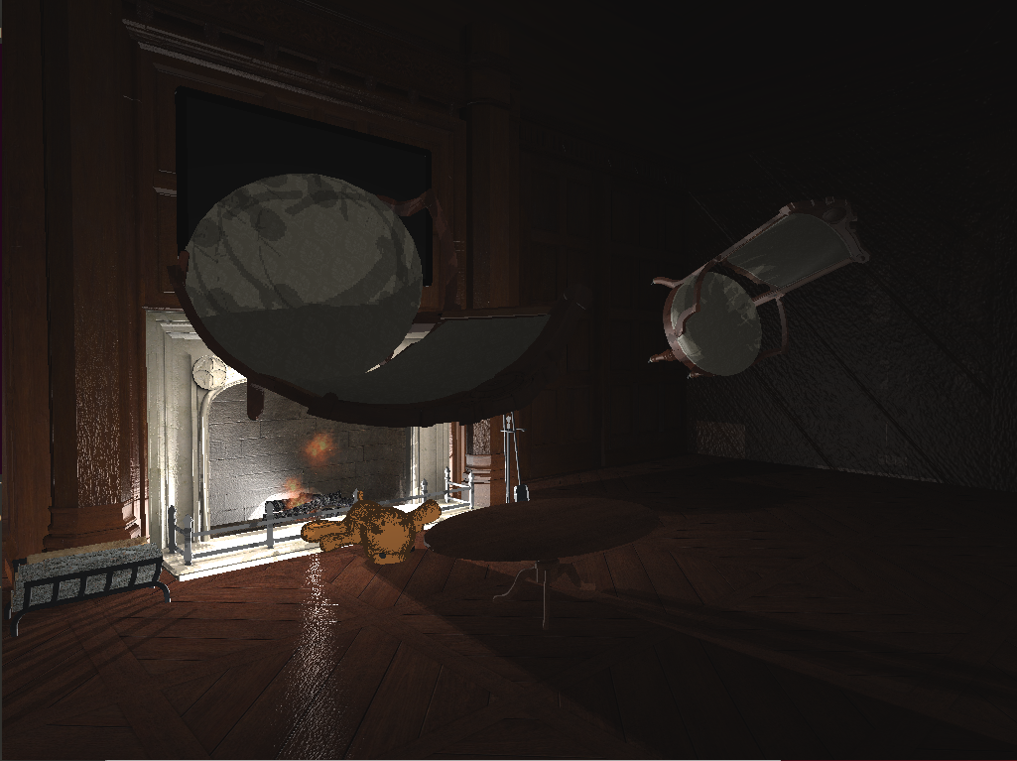
Animation
See actual program

Slide 8
Synchonized Sound
See actual program

Slide 9
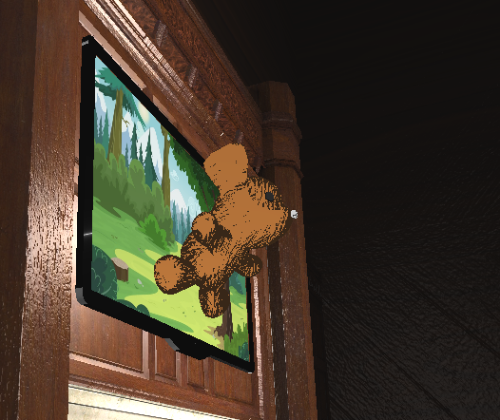
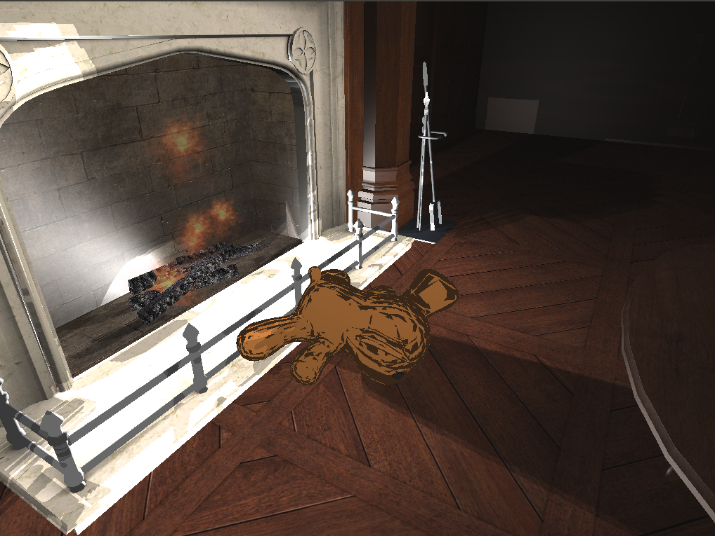
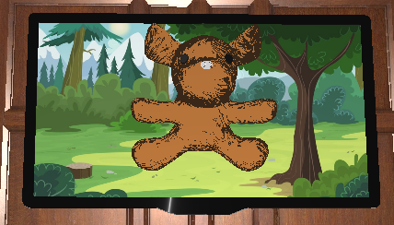
Cell shading
Left/Middle is with normal map because I thought it looked better
Right is without normal map

Slide 10
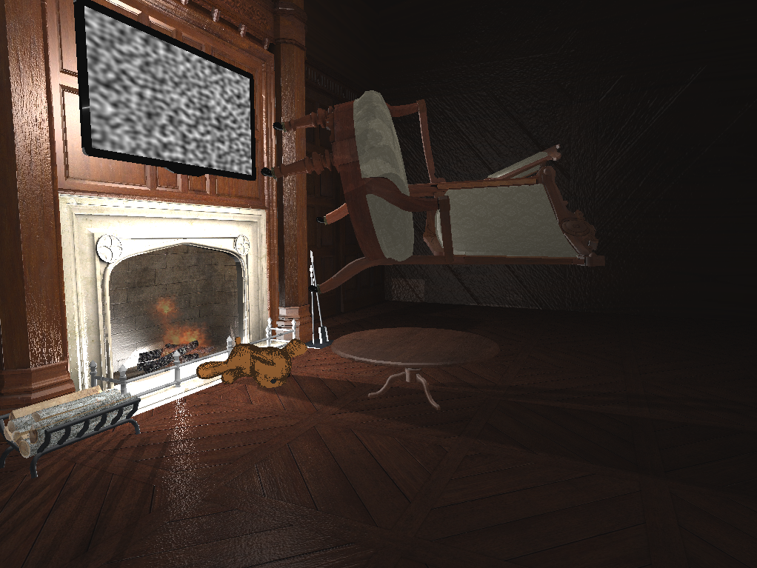
Shadows
Shadow mapping with point lights are used

